Slide 1
Personalized medicine Redefining Cancer Treatment
ALEENA SHIBU
ROLL NO :12

Slide 2
CONTENT
RELEVANCE OF TOP
. PROJECT DESCRIPTION
3. OBJECTIVES OF STUDY
4. EXISTING AND PROPOSED SYSTEM
5. MODULES IDENTIFIED
6. INPUT/ OUTPUT CODE DESCRIPTION
7. DESIGN AND IMPLEMENTATION DETAILS

Slide 3
Relevance of topic
Testing a person’s cancer to find out if a certain type of treatment will work on it.
Looking at a person’s genetics to decide whether he or she can handle a specific medicine.
To determine if a person has certain genetic mutations that could put them at a higher risk for developing cancer.

Slide 4

A Description of the Project
The project focuses on the accurate classification of genetic variations.
Accurate prediction of survival in patients with cancer remains a challenge due to the ever-increasing heterogeneity and complexity of cancer, treatment options and patient populations.
Currently this interpretation of genetic mutations is being done manually. This is a very time-consuming task where a clinical pathologist has to manually review and classify every single genetic mutation based on evidence from text-based clinical literature.

Slide 5
A Description of the Project
Developing a Machine Learning algorithm to automatically classify genetic variations.
To determine if a person has certain genetic mutations that could put them at a higher risk for developing cancer.

Slide 6
Genetic testing is one of the innovative precision medicine technique and the way diseases like Cancer are treated.
A biopsy will be taken of your tumor.
Cancer cells will be isolated and extracted from the biopsy, then their DNA will be sequenced in the lab.
Existing System

Slide 7
To automatically classify genetic variations.
To aid the Doctor in making decisions regarding the correct diagnosis Cancer Class based on the genetic Variation
To distinguishing the cancer is malignant or benign
To reduce the number of treatments patients may try by identifying more targeted treatments earlier.
Objectives of the Study

Slide 8
The project aims at developing a Machine Learning algorithm that uses expert-annotated knowledge base where world-class researchers and oncologists have manually annotated thousands of mutations as a baseline, to automatically classify genetic variations
To aid the Doctor in making decisions regarding the correct diagnosis Cancer Class based on the genetic Variation
It helps to clasiify whether the cancer is malignant or benign
Proposed System

Slide 9
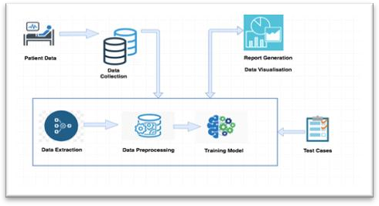
Proposed System

Slide 10
Modules
1 LOADING AND PREPROCESSING OF DATA.
2 VISUALIZING DATA AND FIND CORRELATION AMONG FEATURES AND TARGET LABELS . . . . . . . . . . .
3 USE CLASSIFICATION TECHNIQUES AND FIND THEIR
ACCURACY
4 CONCLUDING THE BEST MODEL

Slide 11
A random forest Classiifer : a meta estimator that fits a number of decision tree classifiers on various sub-samples of the dataset and uses averaging to improve the predictive accuracy and control over-fitting. The sub-sample size is controlled with the max_samples parameter if bootstrap=True (default), otherwise the whole dataset is used to build each tree.
System Design or Algorithms to be used

Slide 12
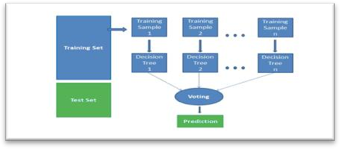
Datasets
Dataset has 9 different classes that we have to predict. Both training and test, datasets are provided into two different files. One (training/test_variants) provides information about the genetic mutation, whereas other (training/test_text) provides the clinical evidence(text) that human experts used to classify the genetic mutations..The collected our dataset from the Kaggle competition and Memorial Sloan Kettering Cancer Center (MSKCC). The dataset has three parameters: genes, variations and clinical text. In the training set, 9 classes of mutations are given. Our goal was to use these three provided variables to predict mutation classes. The training set has 3321 data entries which are about four times as much as the test set. A similar distribution can also be seen with the types of variations. However, there were more types of genes in the test set compare with the number of types in the training set.

Slide 13

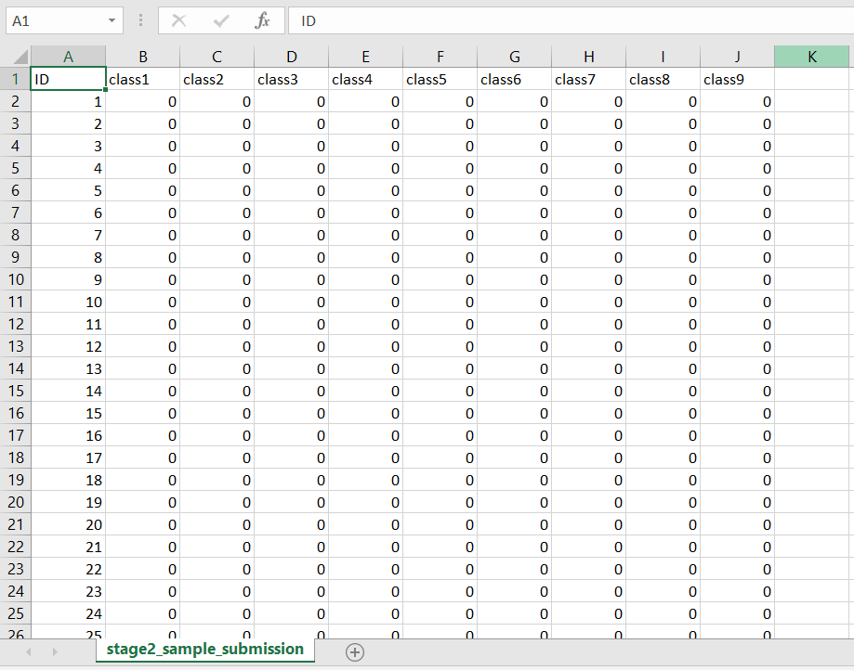

Slide 14
HTML : The HyperText Markup Language, or HTML is the standard markup language for documents designed to be displayed in a web browser. It can be assisted by technologies such as Cascading Style Sheets and scripting languages such as JavaScript.
CSS : Cascading Style Sheets is a style sheet language used for describing the presentation of a document written in a markup language such as HTML.
Python : Python is a computer programming language often used to build websites and software, automate tasks, and conduct data analysis.
FRONT END /BACKEND/TOOLS

Slide 15
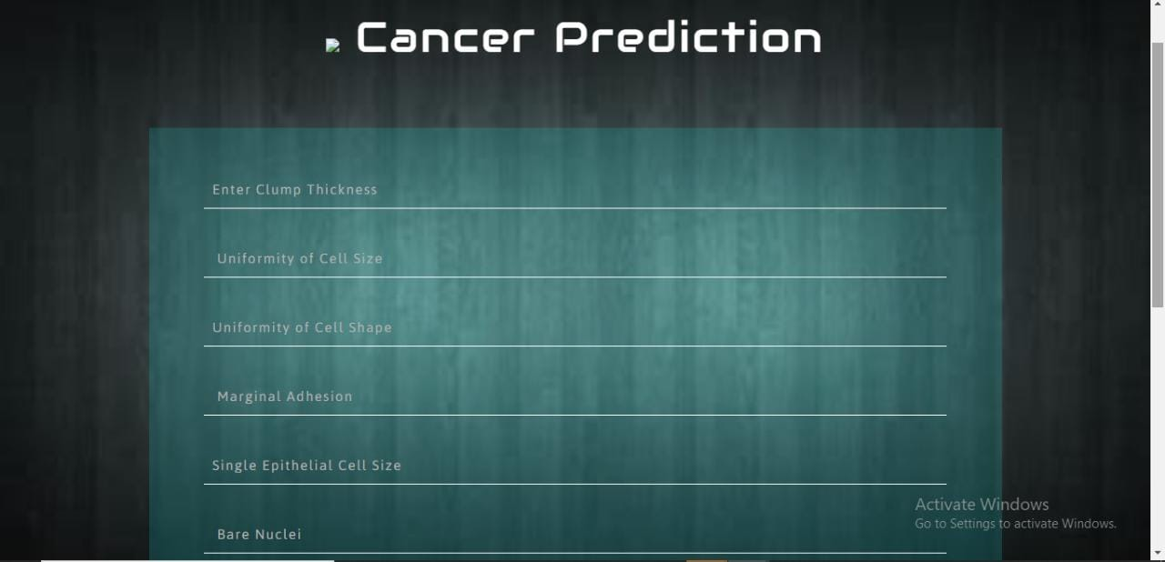

Slide 16
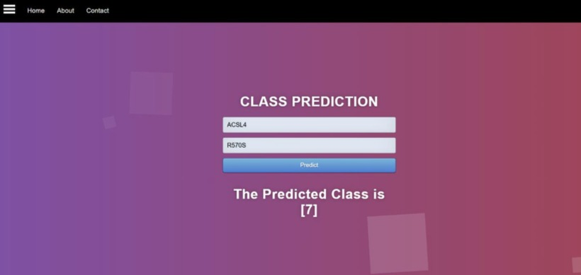
SCREENSHOTS

Slide 17
THANK YOU!

Slide 18
Relevance of topic
Accurate prediction of survival in patients with cancer remains a challenge due to the ever-increasing heterogeneity and complexity of cancer, treatment options and patient populations.
Currently this interpretation of genetic mutations is being done manually. This is a very time-consuming task where a clinical pathologist has to manually review and classify every single genetic mutation based on evidence from text-based clinical literature.
The project aims at developing a Machine Learning algorithm that uses expert-annotated knowledge basewhere world-class researchers and oncologists have manually annotated thousands of mutations as a baseline, to automatically classify genetic variations.

